Slide 1
Computer Abstractions and Technology
Chapter 1

Slide 2
The Computer Revolution
Progress in computer technology
Underpinned by Moore’s Law
Makes novel applications feasible
Computers in automobiles
Cell phones
Human genome project
World Wide Web
Search Engines
Computers are pervasive

Slide 3
Classes of Computers
Desktop computers
Designed to deliver good performance to a single user at low cost usually executing 3rd party software, usually incorporating a graphics display, a keyboard, and a mouse
Servers
Used to run larger programs for multiple, simultaneous users typically accessed only via a network and that places a greater emphasis on dependability and (often) security
Supercomputers
A high performance, high cost class of servers with hundreds to thousands of processors, terabytes of memory and petabytes of storage that are used for high-end scientific and engineering applications
Embedded computers (processors)
A computer inside another device used for running one predetermined application

Slide 4
Review: Some Basic Definitions
Kilobyte – 2¹⁰ or 1,024 bytes
Megabyte– 2²⁰ or 1,048,576 bytes
sometimes “rounded” to 10⁶ or 1,000,000 bytes
Gigabyte – 2³⁰ or 1,073,741,824 bytes
sometimes rounded to 10⁹ or 1,000,000,000 bytes
Terabyte – 2⁴⁰ or 1,099,511,627,776 bytes
sometimes rounded to 10¹² or 1,000,000,000,000 bytes
Petabyte – 2⁵⁰ or 1024 terabytes
sometimes rounded to 10¹⁵ or 1,000,000,000,000,000 bytes
Exabyte – 2⁶⁰ or 1024 petabytes
Sometimes rounded to 10¹⁸ or 1,000,000,000,000,000,000 bytes

Slide 5
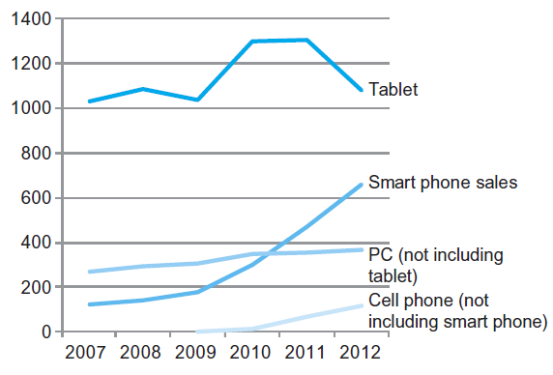
The PostPC Era

Slide 6
The PostPC Era
Personal Mobile Device (PMD)
Battery operated
Connects to the Internet
Hundreds of dollars
Smart phones, tablets, electronic glasses
Cloud computing
Warehouse Scale Computers (WSC)
Software as a Service (SaaS)
Portion of software run on a PMD and a portion run in the Cloud
Amazon and Google

Slide 7
What You Will Learn
How programs are translated into the machine language
And how the hardware executes them
The hardware/software interface
What determines program performance
And how it can be improved
How hardware designers improve performance
What is parallel processing

Slide 8
Understanding Performance
Algorithm
Determines number of operations executed
Programming language, compiler, architecture
Determine number of machine instructions executed per operation
Processor and memory system
Determine how fast instructions are executed
I/O system (including OS)
Determines how fast I/O operations are executed

Slide 9
Below the Program
Applications software
Systems software
Hardware
System software
Operating system – supervising program that interfaces the user’s program with the hardware (e.g., Linux, MacOS, Windows)
Handles basic input and output operations
Allocates storage and memory
Provides for protected sharing among multiple applications
Compiler – translate programs written in a high-level language (e.g., C, Java) into instructions that the hardware can execute

Slide 10
Below the Program, Con’t
High-level language program (in C)
swap (int v[], int k)
(int temp;
temp = v[k];
v[k] = v[k+1];
v[k+1] = temp;
)
Assembly language program (for MIPS)
swap: sll $2, $5, 2
add $2, $4, $2
lw $15, 0($2)
lw $16, 4($2)
sw $16, 0($2)
sw $15, 4($2)
jr $31
Machine (object, binary) code (for MIPS)
000000 00000 00101 0001000010000000
000000 00100 00010 0001000000100000
. . .
C compiler
assembler
Notes:
Computer only understands zeros and ones – instructions of 0’s and 1’s
Early programmers found representing machine instructions in a symbolic notation – assembly language
And developed programs that translate from assembler to machine code
Eventually, programmers found working even in assembler too tedious so migrated to higher-level languages and developed compilers that would translate from the higher-level languages to assembler

Slide 11
Advantages of Higher-Level Languages ?
Higher-level languages
As a result, very little programming is done today at the assembler level
Allow the programmer to think in a more natural language and for their intended use (Fortran for scientific computation, Cobol for business programming, Lisp for symbol manipulation, Java for web programming, …)
Improve programmer productivity – more understandable code that is easier to debug and validate
Improve program maintainability
Allow programs to be independent of the computer on which they are developed (compilers and assemblers can translate high-level language programs to the binary instructions of any machine)
Emergence of optimizing compilers that produce very efficient assembly code optimized for the target machine
Notes:
For lecture

Slide 12
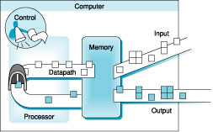
Under the Covers
Five classic components of a computer – input, output, memory, datapath, and control
datapath + control = processor (CPU)

Slide 13
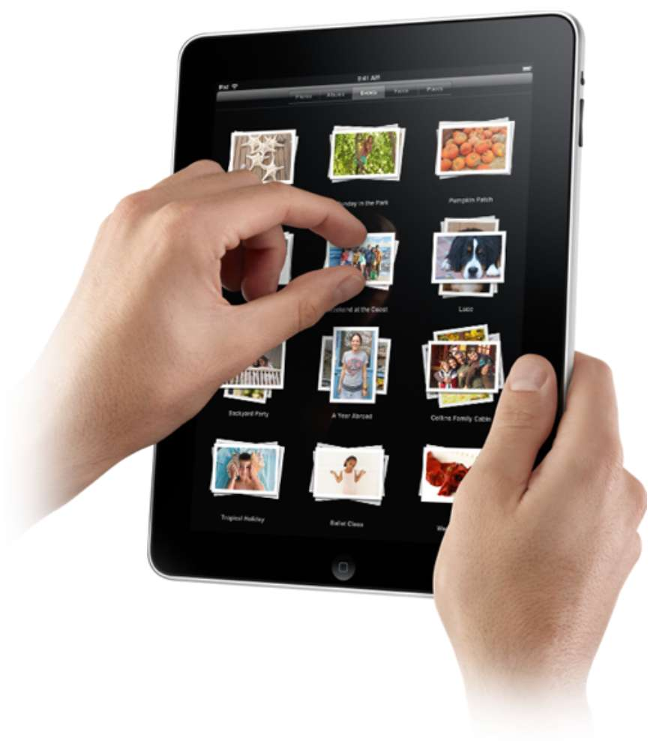
Touchscreen
Post-PC device
Supersedes keyboard and mouse
Resistive and Capacitive types
Most tablets, smart phones use capacitive
Capacitive allows multiple touches simultaneously

Slide 14
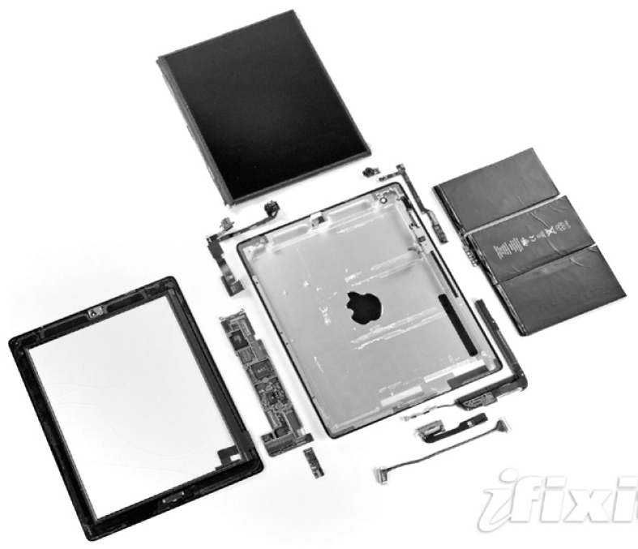
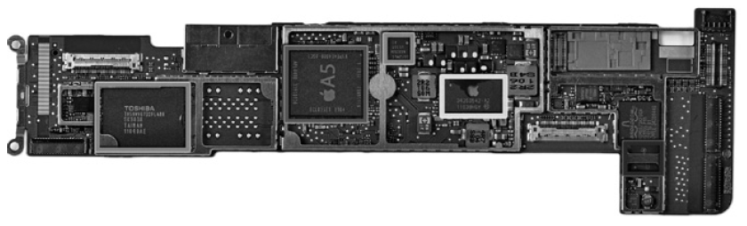
Opening the Box
Capacitive multitouch LCD screen
3.8 V, 25 Watt-hour battery
Computer board

Slide 15
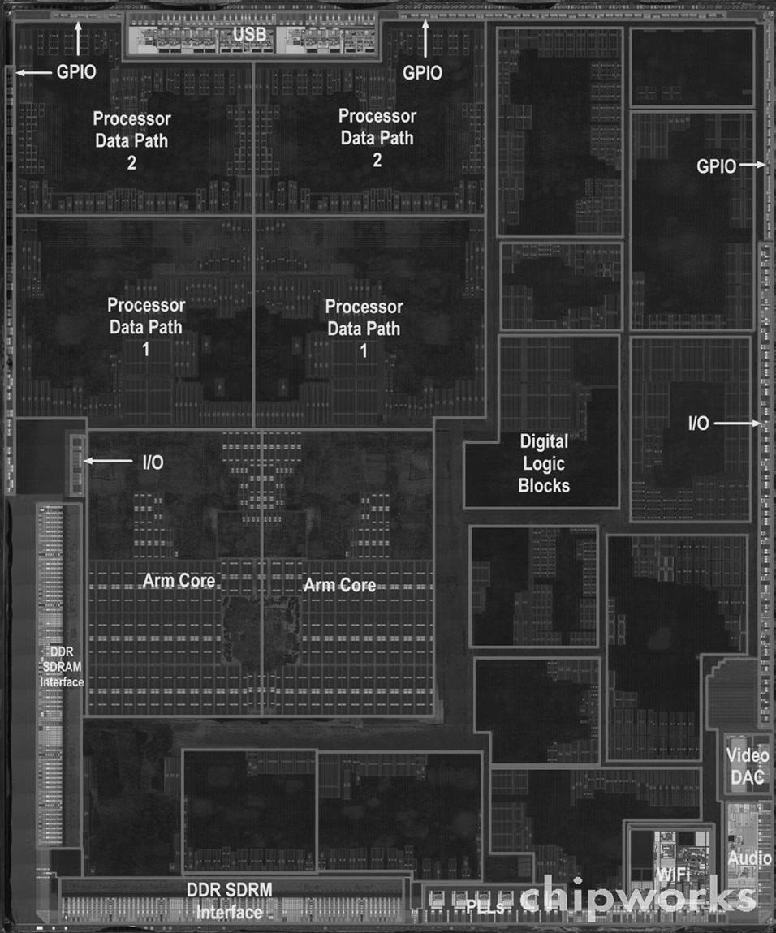
Inside the Processor
Apple A5

Slide 16
Inside the Processor (CPU)
Datapath: performs arithmetic operations on data
Control: sequences datapath, memory, and I/O devices according to the instructions of the program
Cache memory
Small fast SRAM memory for immediate access to data

Slide 17
Instruction Set Architecture (ISA)
Idea to improve design is abstraction.
ISA, or simply architecture – the abstract interface between the hardware and the lowest level software that encompasses all the information necessary to write a machine language program, including instructions, registers, memory access, I/O, …
Enables implementations of varying cost and performance to run identical software
The combination of the basic instruction set (the ISA) and the operating system interface is called the application binary interface (ABI)
ABI – The user portion of the instruction set plus the operating system interfaces used by application programmers. Defines a standard for binary portability across computers.

Slide 18
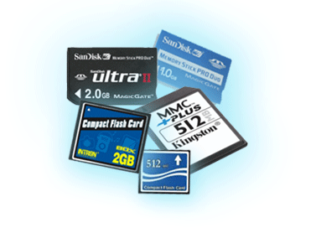
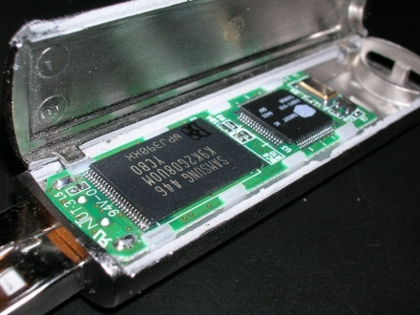
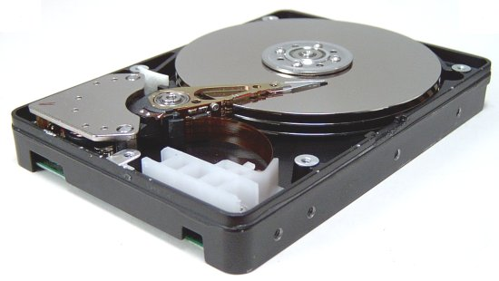
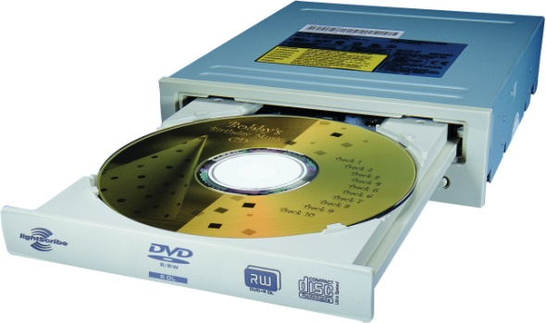
A Safe Place for Data
Volatile main memory
Loses instructions and data when power off
Non-volatile secondary memory
Magnetic disk
Flash memory
Optical disk (CDROM, DVD)

Slide 19
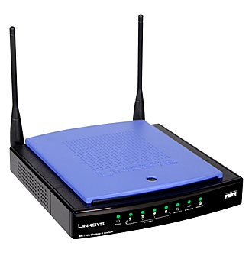
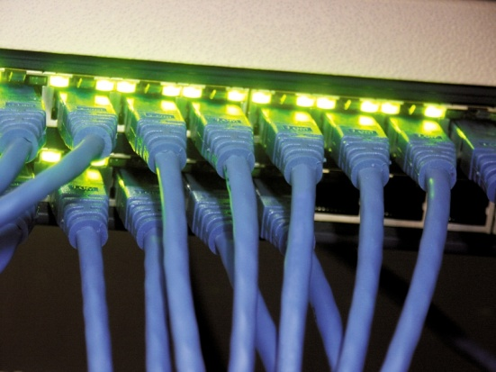
Networks
Communication, resource sharing, nonlocal access
Local area network (LAN): Ethernet
Wide area network (WAN): the Internet
Wireless network: WiFi, Bluetooth

Slide 20
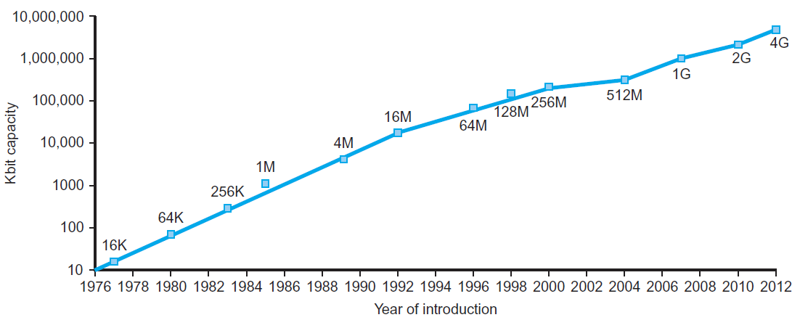
Technology Trends
Electronics technology continues to evolve
Increased capacity and performance
Reduced cost
DRAM capacity
§1.5 Technologies for Building Processors and Memory
Year | Technology | Relative performance/cost
1951 | Vacuum tube | 1
1965 | Transistor | 35
1975 | Integrated circuit (IC) | 900
1995 | Very large scale IC (VLSI) | 2,400,000
2013 | Ultra large scale IC | 250,000,000,000

Slide 21
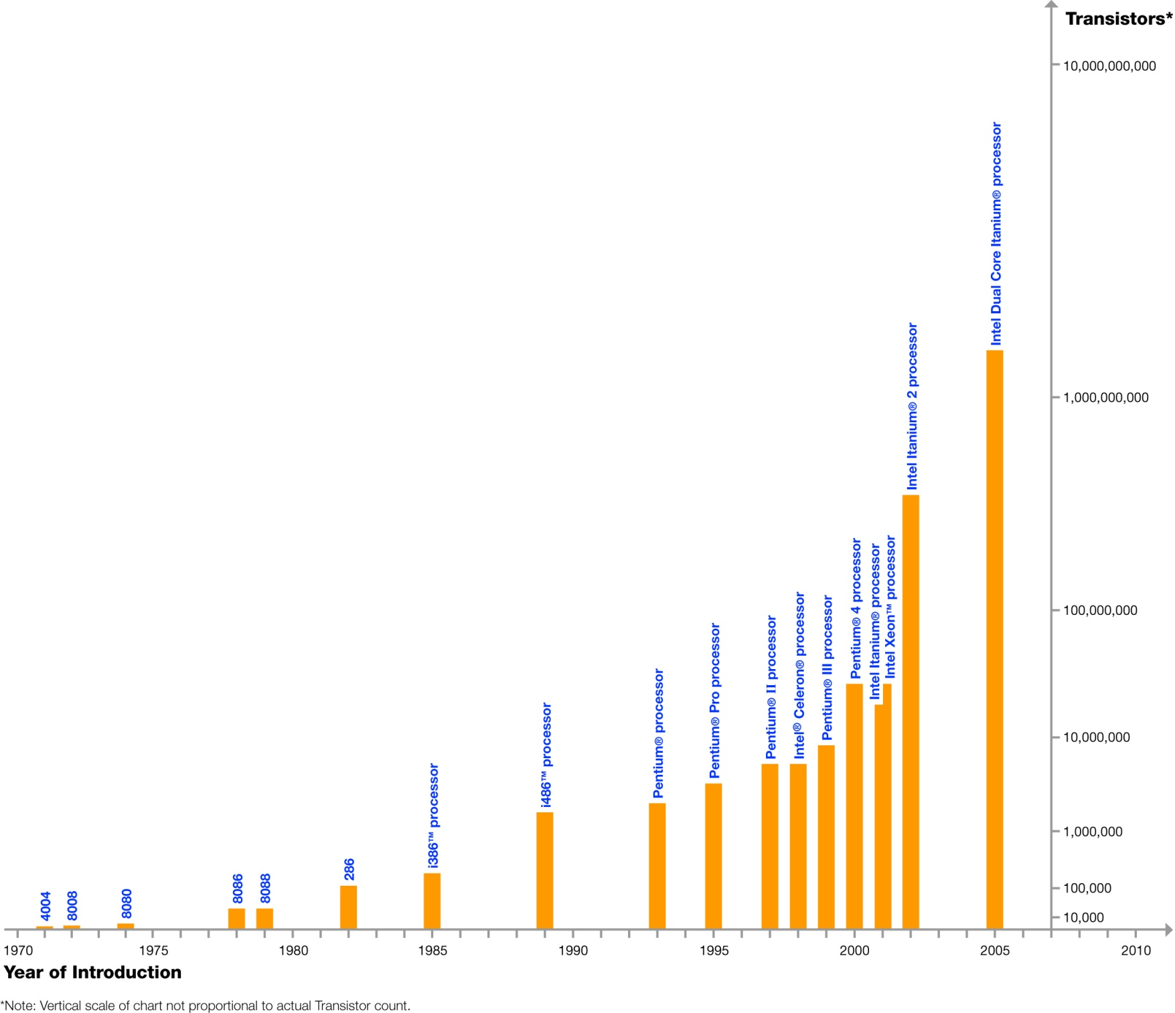
Moore’s Law
In 1965, Intel’s Gordon Moore predicted that the number of transistors that can be integrated on single chip would double about every two years
Dual Core Itanium with 1.7B transistors
feature size
&
die size
Log Scale
Courtesy, Intel ®

Slide 22
Technology Scaling Road Map (ITRS)
Year | 2004 | 2006 | 2008 | 2010 | 2012
Feature size (nm) | 90 | 65 | 45 | 32 | 22
Intg. Capacity (BT) | 2 | 4 | 6 | 16 | 32
Fun facts about 45nm transistors
30 million can fit on the head of a pin
You could fit more than 2,000 across the width of a human hair
If car prices had fallen at the same rate as the price of a single transistor has since 1968, a new car today would cost about 1 cent
Notes:
International Technology Roadmap for Semiconductors

